Slide 1

Movie Genre Classification using Title and Description
Text Mining Project - Final Presentation
OPIM 5671 Team 1
Guided by: Prof. Sudip Bhattacharjee
Team Members: Chetan Khatri, Andrea Mechery, Shubham Patil,
Balaji Prasad Thulasiram, and Kevin Connolly
Notes:
Balaji

Slide 2


Agenda
Business Relevance
Dataset Overview
Exploratory Data Analysis
Modeling Approach
Modeling Results
Business Implementation
Notes:
Balaji

Slide 3
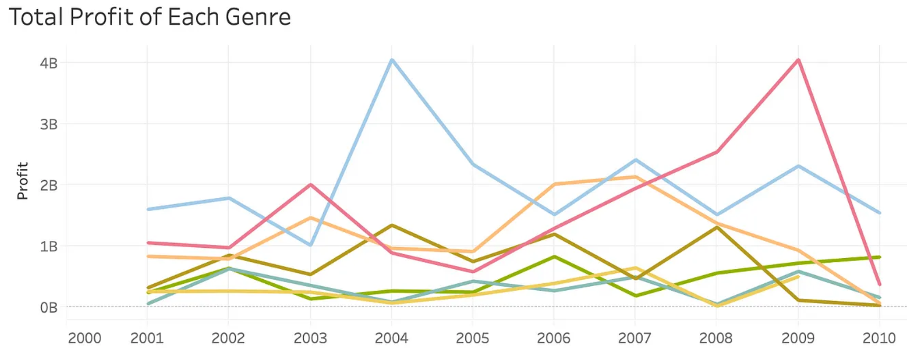
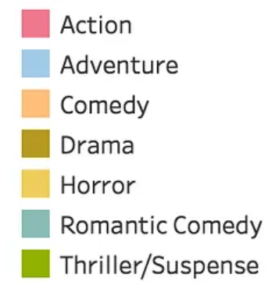
Business Relevance
Importance of Genre Classification
It assists streaming platforms and production companies in listing and promoting trending genres.
It facilitates in building hype to draw viewers to their preferred genres.
Developing strategic marketing and advertising campaigns.
Provides foundation for critics to debate and analyze the movie.
https://medium.com/@ordosnb/movie-genre-and-profits-913a3142a0fb
Notes:
Balji

Slide 4
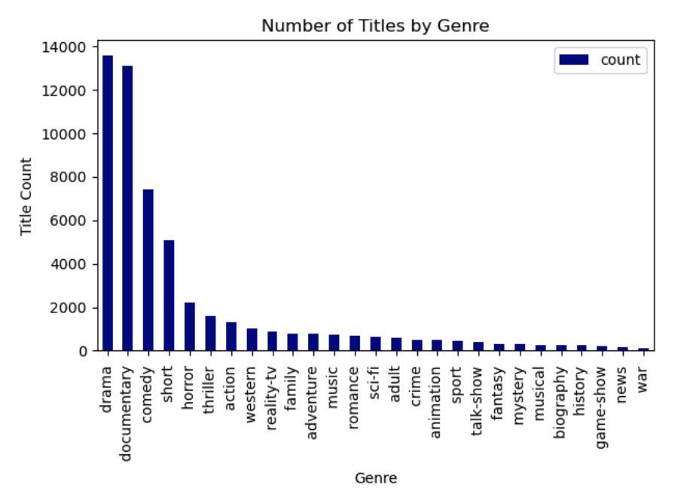
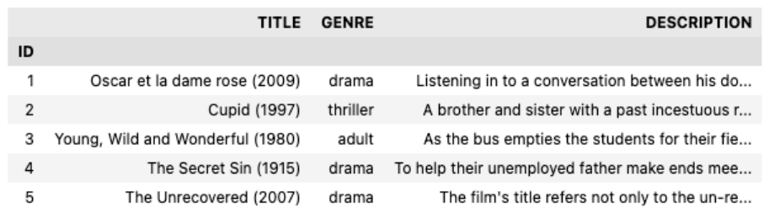
Dataset Overview
The dataset is sourced from IMDb (Internet based movie database). It is a subsidiary of Amazon used by audience to review and rate movies.
Dataset Format:
We are predicting the movie's genre based on the title and description.
Genre is the Target Variable.
Notes:
Kevin

Slide 5
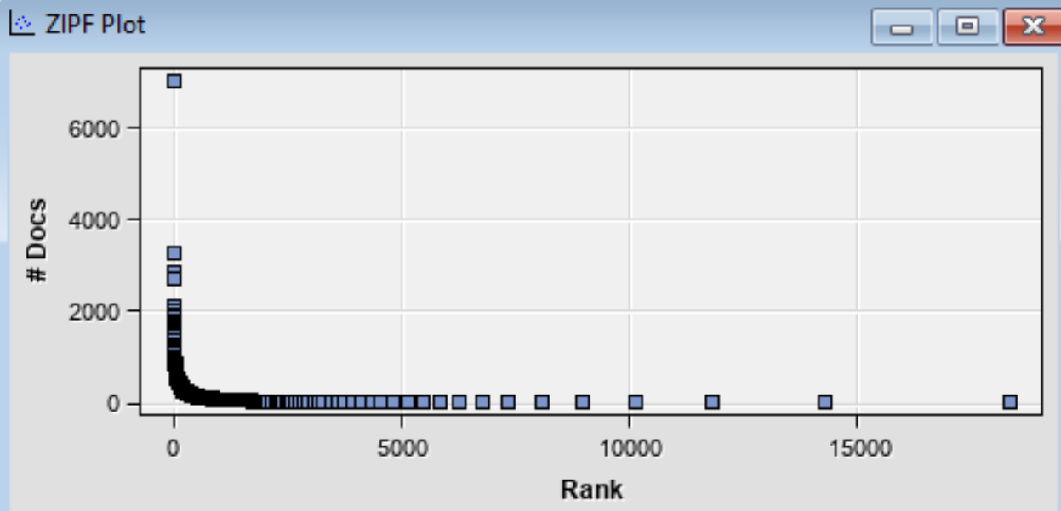
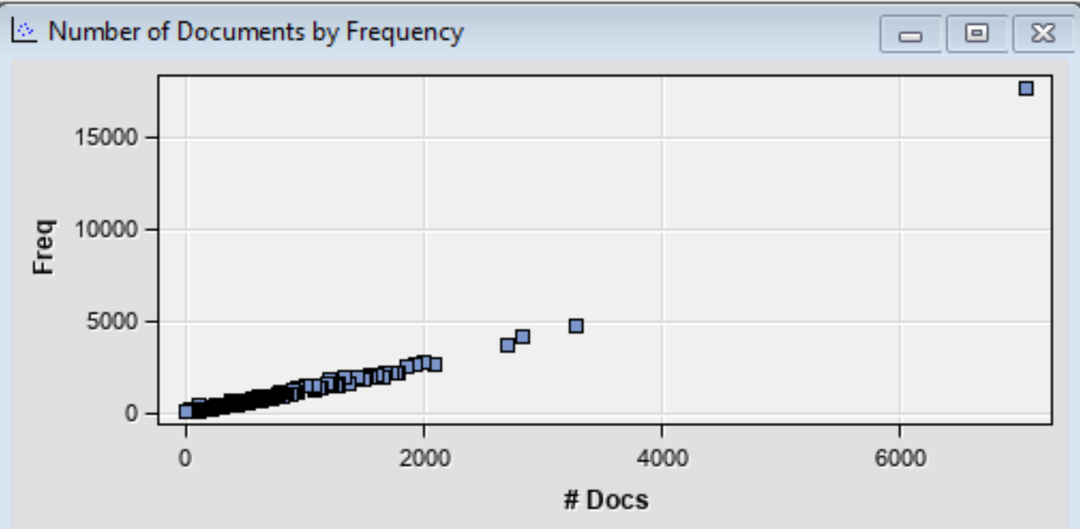
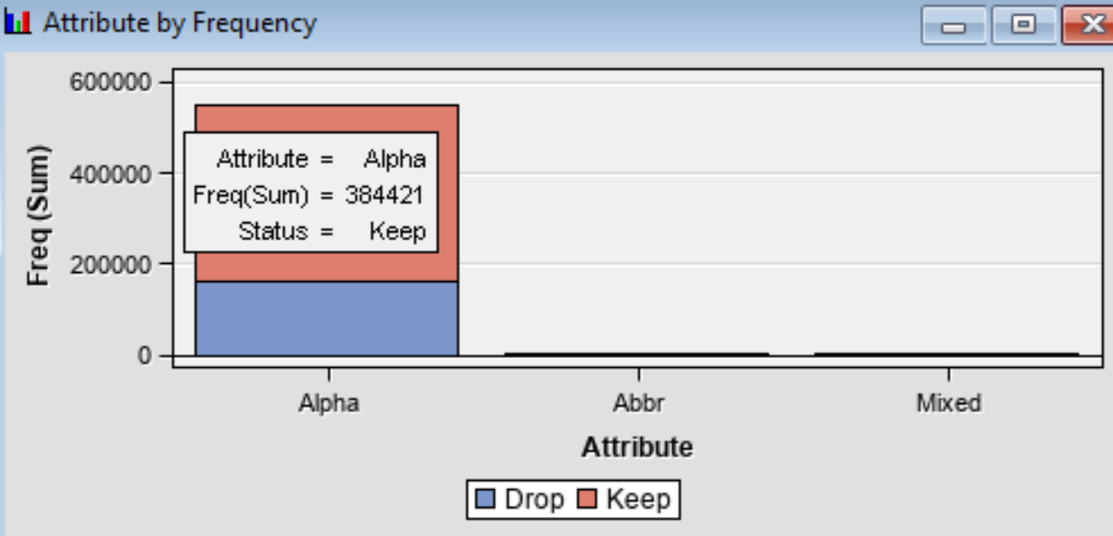
Exploratory Data Analysis
Zipf’s Plot-
Number of documents by frequency-
We dropped the terms as they appeared in very few docs
The plot is slowly decaying.
The graph is monotonic/linear.
Frequency of alpha attributes is significantly greater.
Notes:
Shubham

Slide 6
Modeling Approach
Model 1.1 (Base Model)
-Default parameters on Text Parsing, Text Filter, Text Cluster nodes.
-All models.
-None of the model performed well, -TRB misclassification rate 0.56
Model 1.2 (TRB, Different Term Weight)
-Added Stop List (Top 10 most frequent terms)
-Term Weight: Default, Entropy, Mutual Information, IDF, None
-SVD Resolution Low and High, Max SVD Dimension 100
-None of the TRB Model produced good results. Misclassification Rate of 0.56
Performance Challenge
-Model took 7 hrs to run due to high exhaustiveness.
-Used Sample Node to reduce data size, maintaining majority and minority class.
Model 1.4 (TRB with User Topics)
-Partitioned the data as Train: 80 & Validation: 20
-Term Weight = Entropy.
-Identified 25 terms for each genre and created user topic list.
-Train misclassification rate dropped (0.51 to 0.28) but no change in validation misclassification rate.
-Model is overfitting on training data.
Model 1.3 (TRB- Undersampled Data) - Used 30% undersampled data with partition, Train: 90 & Validation: 10
-The model runtime dropped substantially. But no change in results due to undersampling. -TRB validation misclassification rate 0.55
Notes:
Chetan w/ input from Kevin

Slide 7
Modeling Approach
Model 2.1 (Base Model)
-Used only 4 genres (Drama, Comedy, Action, Horror)
-Default weights, Min no. of documents:10
-Text Topic- No. Of multi-term clusters:4
-Neural Network-0.28 and Regression-0.29 are the best models with min misclassification rate.
Model 2.2 (Regression & Neural Network)
-Partition: Train:50, Validation:50
-Term weight: Default, Entropy, Mutual Info, IDF, None ; Min no. of docs:10
-Entropy is best term weight, decided to use for model tuning.
-Misclassification rate, Neural Network (Entropy):0.262, Regression (Entropy):0.263
Model 2.4 (Regression and Neural Network)
-With user topics in Text Topic node.
-Regression with both forward and backward selection model.
-Both models with SVD and without SVD.
-Regression model with backward selection performed best with misclassification rate: 0.26
Model 2.3 (Regression & Neural Network)
-Term weight: Entropy, Min no. of documents: 10, 12, 16, 7, 4
-No significant difference in misclassification rate. Decided min no. of documents as 10.
Notes:
Chetan w input from Kevin

Slide 8
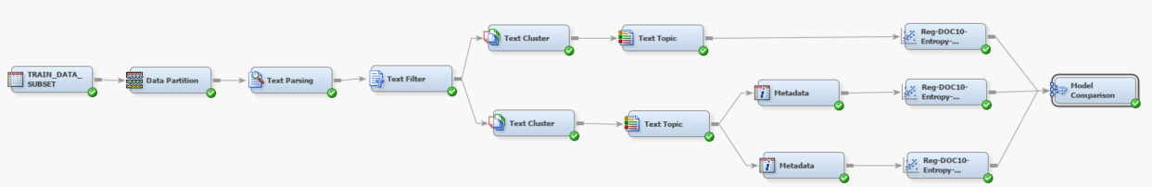
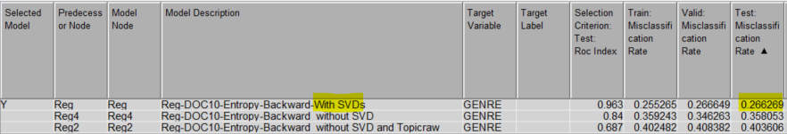
Modeling Results
Final Model 2.5 (Regression model with SVD & without SVD & Text Topic Raw)
-Partition: Train:40, Validation:30, Test:30
-Term Weight: Entropy
-With backward selection and with SVD has misclassification rate: 0.26
-With backward selection and without SVD has misclassification rate: 0.35
-With backward selection and without SVD & Text Topic Raw has misclassification rate: 0.40
Conclusion: Regression model with backward selection is our best performing model in terms of validation misclassification rate. As we remove SVD dimensions from our model the performance drops. Adding SVD dimensions would give us better results however complex interpretability.
Notes:
Chetan with input from Kevin

Slide 9

Business Implementation
Product Recommendations
Inventory Management
Customer Segmentation
Notes:
Andrea Mechery
Implementation of Genre Classification to aid in Product Recommendations, Inventory Management, Customer Segmentation.
Doesn’t only pertain to Movies, this can be used for Books, Clothing, Fashion, Retail, etc.

Slide 10
Questions?
Notes:
Andrea

Slide 11
Appendix Slides

Slide 12
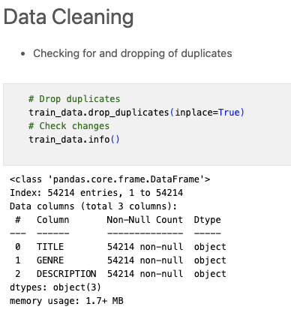
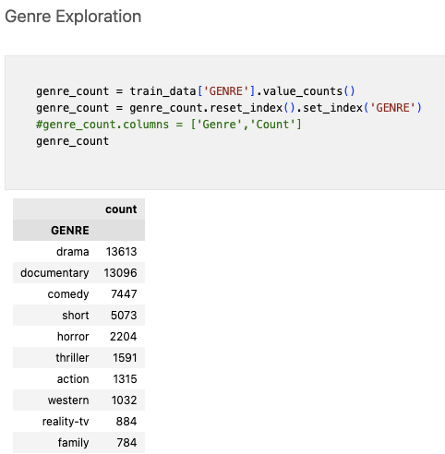
Data Cleaning
Notes:
Andrea Mechery
Implementation of Genre Classification to aid in Product Recommendations, Inventory Management, Customer Segmentation.
Doesn’t only pertain to Movies, this can be used for Books, Clothing, Fashion, Retail, etc.

Slide 13
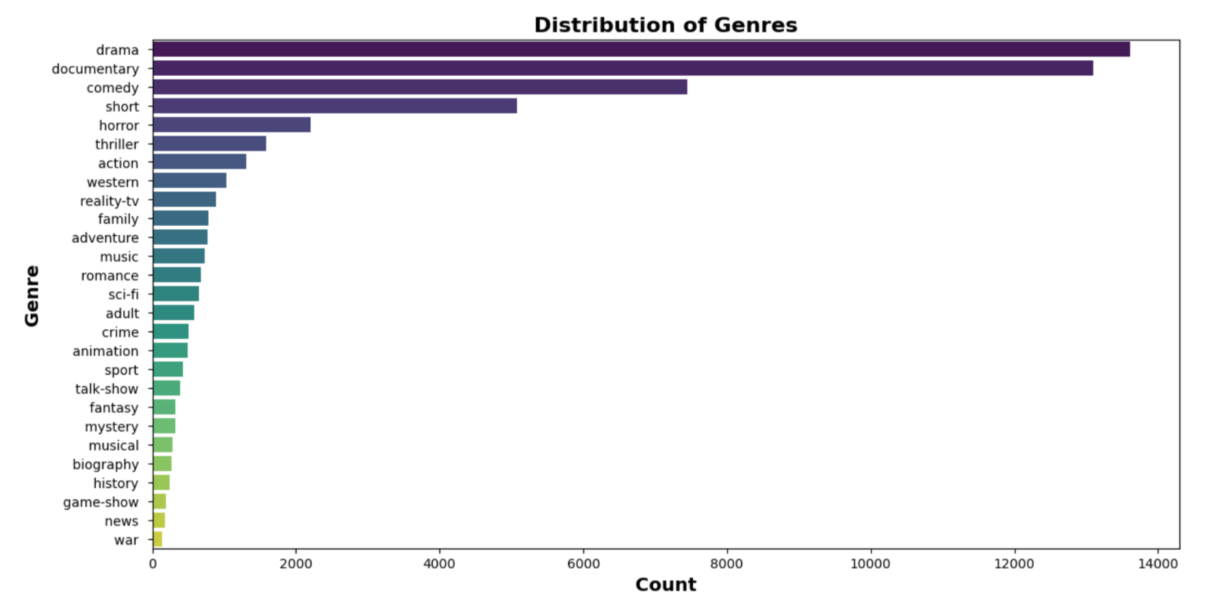
Distribution of Genres
Notes:
Andrea Mechery
Implementation of Genre Classification to aid in Product Recommendations, Inventory Management, Customer Segmentation.
Doesn’t only pertain to Movies, this can be used for Books, Clothing, Fashion, Retail, etc.

